Slide 1
Neonatal Resuscitation 7th Edition

Slide 2
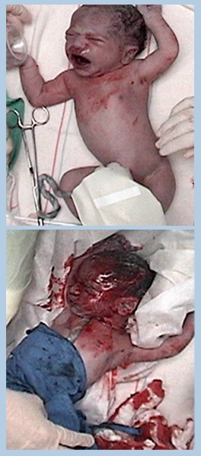
Interrupted Normal Transition
Depressed respiratory effort – apnea or tachypnea
Compromised heart –bradycardia or tachycardia
Decreased muscle tone
Low oxygen saturation
Low blood pressure
Normal
transition
Interrupted
transition
Notes:
A baby may encounter difficulty before labor, during labor, or after birth. Some of the problems that may disrupt normal transition are
The baby may not breathe sufficiently to force fluid from the alveoli, or foreign material such as meconium may prevent air from entering the alveoli.
Excessive blood loss may occur, or there may be inadequate cardiac contractility or bradycardia from hypoxia and ischemia.
Lack of oxygen or ventilation of the newborn’s lungs results in sustained constriction of the pulmonary arterioles, preventing arterial blood from becoming oxygenated.
Prolonged lack of adequate perfusion and oxygenation to the baby’s organs can lead to brain damage, damage to other organs, or death.

Slide 3
Resuscitation Flow Diagram
Steps to evaluate and resuscitate a newborn:
5 blocks:
Initial assessment
Airway (A)
Breathing (B)
Circulation (C)
Drugs (D)
Diamonds indicate ASSESSMENT
Rectangles show ACTION
Notes:
The flow diagram begins with the birth of the baby. Each resuscitation step is shown in a block. Below each block is a decision point to help decide whether proceeding to the next step is needed.
Diamonds indicate ASSESSMENT
Rectangles show ACTION
The 5 blocks are:
Initial assessment
Airway (A)
Breathing (B)
Circulation (C)
Drugs (D)

Slide 4
Be Prepared to Resuscitate Every Newborn
Always be prepared!
Antepartum and intrapartum factors will help identify some at-risk babies
Some babies who need resuscitation have no risk factors
Notes:
Be Prepared to Resuscitate Every Newborn
Always be prepared!
Antepartum and intrapartum factors will help identify some at-risk babies
Some babies who need resuscitation have no risk factors

Slide 5
Perinatal Risk Factors
Antepartum factors:
Intrapartum factors:
Preterm or post term dates
Maternal diabetes
Hypertension
Bleeding
Maternal infection –
Malaria, HIV, etc.
Premature rupture of membranes
Multiple gestation
Others
Instrumented delivery
Breech presentation
Premature labor
Chorioamnionitis
Meconium
Prolapsed or nuchal cord
Shoulder dystocia
Significant bleeding
Others
Notes:
In many cases, delivery of a depressed newborn can be anticipated on the basis of the antepartum and intrapartum history.

Slide 6
Questions Before Birth
Before birth, ask the obstetrical provider the following key questions:
What is the expected gestation?
Is the amniotic fluid clear?
Additional risk factors?
Umbilical cord management plan?
Notes:
Before birth, ask the obstetrical provider the following four key questions:
What is the expected gestation?
Is the amniotic fluid clear?
How many babies are expected?
Are there any additional risk factors?

Slide 7
Initial Steps of Newborn Care
You will learn about:
Rapid assessment of the newborn
Initial steps of newborn care
If additional steps are required
Persistent cyanosis or labored breathing
Use of pulse oximeter if available
Giving supplemental oxygen
Continuous positive airway pressure
Actions for meconium-stained amniotic fluid
Notes:
Lesson 3 presents the initial step of newborn care.
In Lesson 3 – You will learn about
How to perform a rapid assessment of the newborn.
The initial steps of newborn care
How to determine if additional steps are required
What to do if the baby has persistent cyanosis or labored breathing
How to use a pulse oximeter and interpret the results
How to give supplemental oxygen
When to consider using continuous positive airway pressure (CPAP)
What to do when meconium-stained amniotic fluid is present

Slide 8
Birth and Umbilical Cord Clamping
Mark the time of birth when last fetal part emerges from mother’s body
Current evidence shows delaying cord clamping to 30-60 second benefits baby (if placental circulation intact)
Before birth establish plan with obstetric provider for timing of umbilical cord clamping
Notes:
At the beginning of this lesson there is discussion about clamping the cord.
Timing of the cord clamp is the subject of ongoing research. Baby should be placed skin-to-skin on mother’s chest or abdomen, or held securely in a warm, dry towel or blanket. Very preterm – wrapped in a warm blanket or polyethylene plastic to maintain temperature. During the interval between birth and umbilical cord clamping, the obstetric provider and neonatal team should evaluate the baby’s tone, and breathing effort and begin the initial steps of newborn care. Cord clamping should not be delayed if the placental circulation is not intact, multiple gestation birth, or with baby’s who are not vigorous.
Potential Benefit:
Preterm – decreased mortality, higher blood pressure and blood volume, less need for blood transfusion after birth, fewer brain hemorrhages and a lower risk of necrotizing enterocolitis.
Term – may decrease chance of developing iron-deficiency anemia and may improve neurodevelopmental outcomes.
Potential Adverse:
Delaying resuscitation for compromised newborns and increased risks of polycythemia and jaundice

Slide 9
Evaluating the Newborn
Immediately after birth, the following questions must be asked:
Term gestation
Good tone
Breathing or crying
Notes:
This initial evaluation may occur during the interval between birth and umbilical cord clamping. You rapidly evaluate 3 questions and share with the team including the obstetric:
Does the baby appear to be term?
Does the baby have good muscle tone? (active with flexed extremities)
Is the baby breathing or crying?
If the answer to all of the initial questions is “Yes,” and the newborn is term, the newborn may remain with mother to receive initial steps while on mother’s chest or abdomen and continue transition.
If the answer to any one of these questions is “No,” the newborn should be brought to a radiant warmer because additional interventions may be required.
Instructor Tip: Assess these criteria simultaneously. The decision to provide routine care or proceed with initial steps takes only a few seconds.

Slide 10
Initial Steps of Newborn Care
For a vigorous term newborn
Provide warmth with mother or under radiant warmer
Position head and neck to open airway
If needed, clear secretions
Dry
Stimulate
Notes:
If vigorous the baby can remain with the mother and have the initial steps performed on the mother’s chest or abdomen. Warmth is obtained by direct skin-to-skin contact and covering the baby with a warm towel or blanket. If necessary, secretions in the upper airway can be cleared by wiping the baby’s mouth and nose with a cloth. Reserve gentle suction with a bulb syringe for babies with meconium-stained fluid, secretions that are obstructing the baby’s breathing, and those that are having difficulty clearing their secretions. After the initial steps are completed, continue monitoring the newborn’s breathing, tone, activity, color, and temperature to determine if additional interventions are required.
If the answer to any of the initial assessment questions “No”, the baby should be brought to a radiant warmer because additional interventions may be required. The initial steps are performed under a radiant warmer so the resuscitation team has easy access to the baby (without heat loss). The initial steps are provided under the radiant warmer.
Babies born preterm are more likely to have difficulty with transition and should be evaluated carefully under a radiant warmer while the initial steps are performed.
For example, they have more difficulty expanding their lungs, establishing good respiratory effort, and maintaining body temperature. If the baby is born at a late -preterm (34-36 weeks) and has stable vital signs with good respiratory effort, the baby can be brought to the mother within several minutes to continue transition. Lesson 9 will cover the birth of preterm infants.

Slide 11
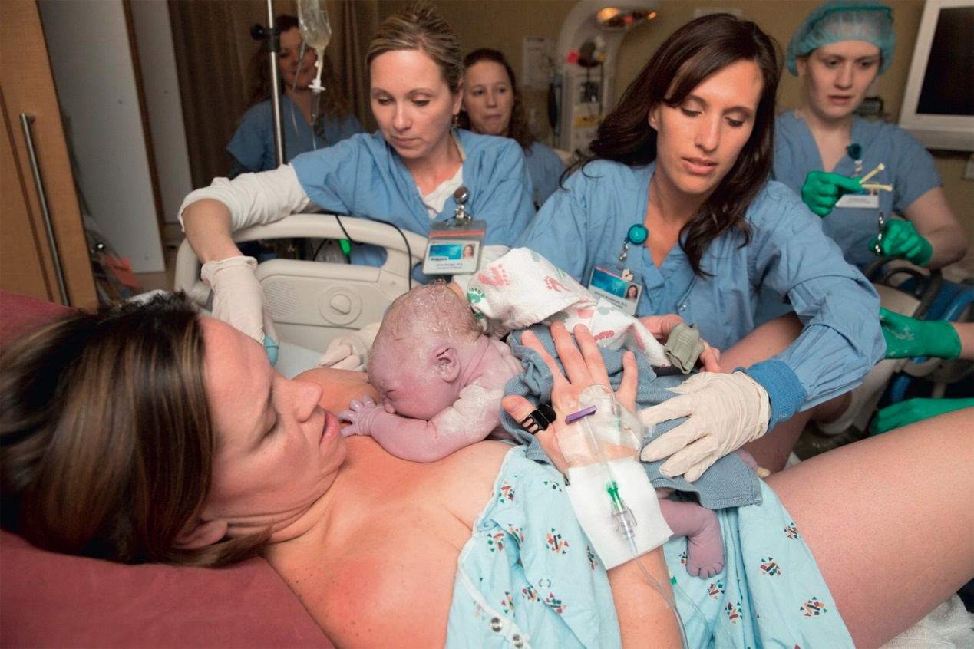
Routine Care
90% of newborns are vigorous term babies with no risk factors
Should remain with mothers to promote bonding, initiate breastfeeding and receive newborn care
Notes:
For babies born vigorous and with no risk factors, provide routine care while remaining with mother. Similarly, a baby with certain risk factors, who responded well to the initial steps of newborn care, may only need close observation an does not need to be separated from mother.

Slide 12
Opening the Airway
Position baby on back
Slightly extend the neck in “sniffing position”
Avoid hyperextension or flexion of the baby’s neck
Notes:
Once the newborn has been placed under a preheated radiant warmer and dried, the next step is to ensure “A” of the ABCs—establishment of an open airway. Correct positioning of the newborn will bring the posterior pharynx, larynx, and trachea in line, which will facilitate unrestricted air entry.

Slide 13
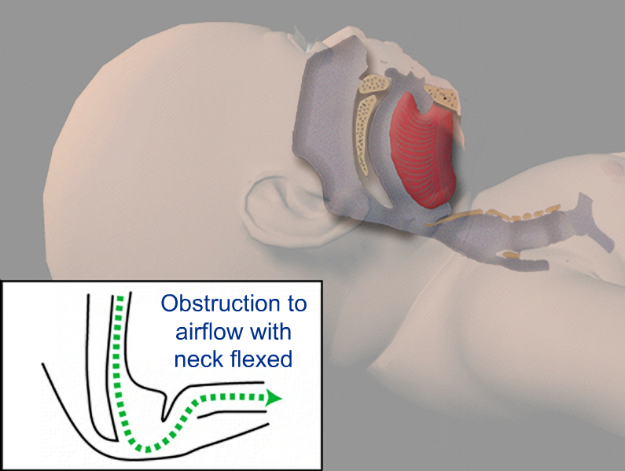
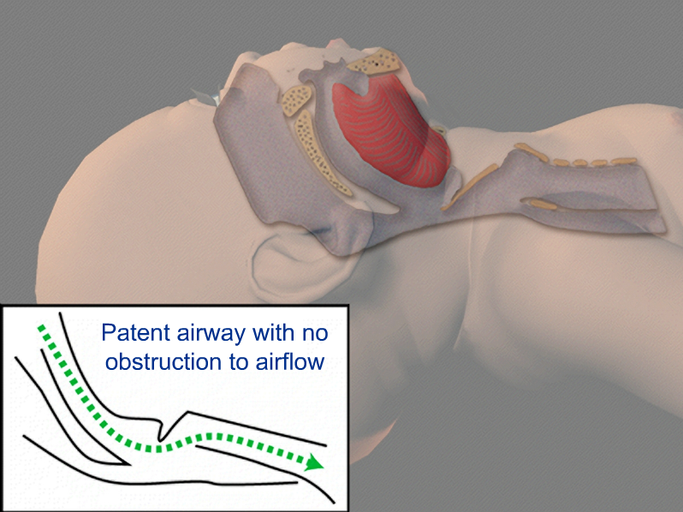
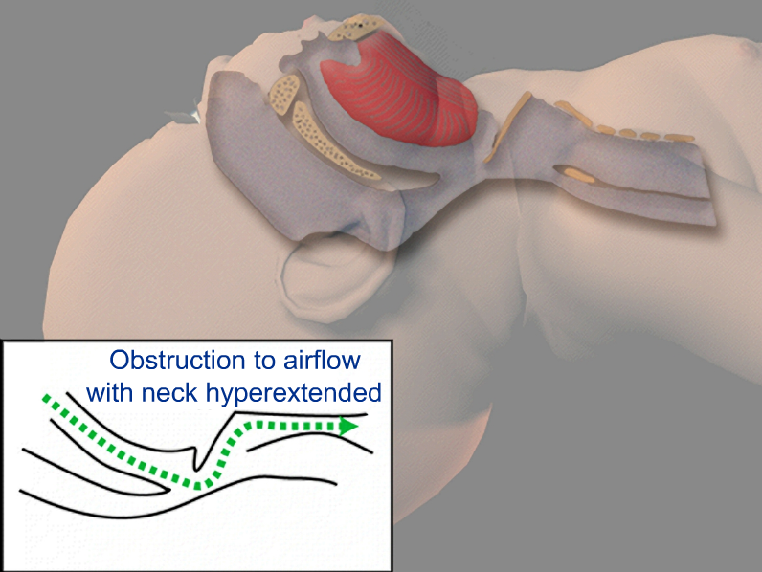
Opening the Airway
Notes:
The newborn should be placed on his or her back, with the neck slightly extended.
Care should be taken to prevent hyperextension or flexion of the neck, since either may decrease air entry.
To help maintain correct position, you may place a rolled blanket or towel under the shoulders, elevating them three fourths of an inch to 1 inch off the mattress. This roll may be particularly useful if the newborn has a large occiput.
Correct positioning allows an open airway to be maintained. In addition, the newborn will be in the optimal position if assisted ventilation becomes necessary.

Slide 14
If Needed, Clear Secretions from Airway
Wipe nose and mouth with towel
If necessary, gently suction with a bulb syringe. Suction mouth first, then nose … “M” before “N”
Brief, gentle suctioning is usually adequate
Vigorous suction may injure tissues and cause bradycardia or apnea
Notes:
If no meconium is present, simply wipe mouth. If the newborn has copious secretions coming from the mouth, turn the head to the side so that secretions will collect in the cheek and be easily removed. Reserve gentle suction with a bulb syringe for babies with meconium-stained fluid or secretions that are obstructing the baby’s breathing, and those that are having difficulty clearing their secretions. The mouth is suctioned before the nose to ensure that there is nothing for the newborn to aspirate if he or she should gasp when the nose is suctioned..
When you suction, particularly when using a catheter, be careful not to suction vigorously or deeply. Stimulation of the posterior pharynx during the first few minutes after birth can produce a vagal response, causing severe bradycardia or apnea.

Slide 15
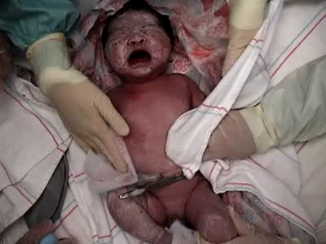
Dry and Stimulate
Dry thoroughly
Remove wet linen
Reposition the head
Click on the image to play video
Notes:
Wet skin increases evaporative heat loss. Use warm towels or blankets and gently dry any fluid. Discard wet towels and use fresh warm towels for continued drying. If 2 people are present. Second person can be drying the baby while the first person is positioning and clearing the airway.
Drying is not necessary for very preterm babies (less than 32 weeks gestation) because they should be covered immediately in polyethylene plastic. Prevention of preterm newborn heat loss is described in Lesson 9.

Slide 16
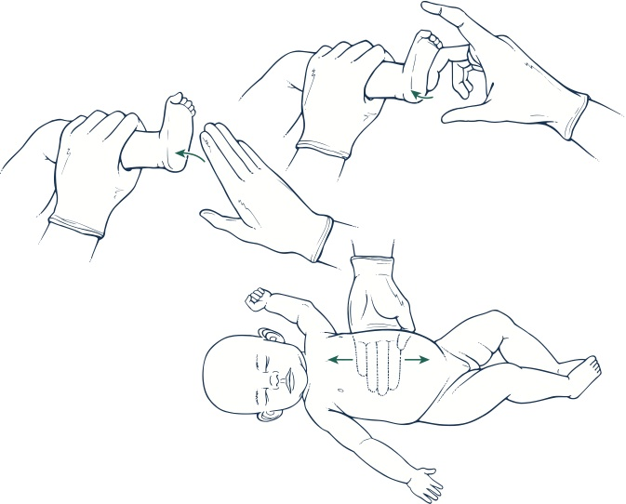
Stimulate Breathing
If baby is still not breathing – gently rub the baby’s back, trunk or extremities for a few seconds.
If apnea remains, begin PPV
Notes:
If, after drying and repositioning, the newborn does not have adequate respirations, additional tactile stimulation may be provided briefly to stimulate breathing. Safe and appropriate methods of providing additional tactile stimulation include
Gently rubbing the back, trunk, or extremities for a few seconds.
If a newborn remains apneic despite rubbing the back or extremities for several seconds, begin PPV as described in next lesson.

Slide 17
Harmful Forms of Stimulation
Slapping back or buttocks
Shaking
Continued tactile stimulation in a baby who is not breathing wastes valuable time. For persistent apnea, give positive-pressure ventilation promptly!
Notes:
Overly vigorous stimulation is not helpful and can cause serious injury. The forms of stimulation listed in this slide may cause bruising, fractures, tearing of internal organs, brain damage, or other consequences.
If a baby is in primary apnea, almost any gentle stimulation will initiate breathing. If a baby is in secondary apnea, no amount of stimulation will work.

Slide 18
Assess Newborn’s Response
Respirations: Is baby breathing or crying?
If baby is not breathing or is gasping proceed to PPV
Heart rate: Is HR more than 100 bpm?
Listen with a stethoscope on left side of chest
Count number of beats in 6 seconds and multiply by 10
Tap out HR with your finger
If available, use pulse oximeter or ECG monitor
Notes:
The evaluation should take no more than an additional 30 seconds. If the baby does not have adequate spontaneous respirations and a hart rate of 100 bpm or higher within 1 minute of birth you should begin PPV. Ventilation of the baby’s lungs is the most important and effective action during neonatal resuscitation.
If you cannot determine the heart rate by physical examination and baby is not vigorous, ask another team member to quickly connect and evaluate the heart rate using a pulse oximeter or ECG monitor. Cautions: Pulse oximetry may not function if the baby’s heart rate is low or if the baby has poor perfusion. In this case ECG monitoring is preferred. In some cases the ECG may show an electrical signal, although the heart is not actually pumping blood (pulseless electrical activity.) Pulseless electrical activity is treated the same as an absent heart rate.

Slide 19
Evaluate the Baby:
Respirations and Heart Rate
Notes:
Continuing to administer free-flow oxygen or providing tactile stimulation to a non-breathing or gasping newborn or baby whose heart rate remains <100 bpm is of little or no value and delays appropriate treatment. If cyanosis persists despite supplemental oxygen, a trial of CPAP or positive-pressure ventilation is indicated.

Slide 20
Not Breathing Heart Rate Low
Start PPV if baby is not breathing
Start PPV if baby appears to be breathing but heart rate below 100
Call for immediate additional help if you are the only provider
If baby has not responded to initial steps in first minute of life proceed to PPV
Notes:
What do you do if the baby is not breathing or the heart rate is low after the initial steps?
Begin PPV for no respiratory effort or gasping.
Begin PPV for a baby who appears to be breathing but heart rate is below 100 bpm.
Call for immediate additional help if you are the only one taking care of the baby.
Details of PPV are in the next lesson.

Slide 21
Breathing, HR 100, Cyanosis
Cyanosis – administer free-flow oxygen adjusting concentration guided by pulse oximetry. Gradually decrease oxygen as baby’s condition improves.
Labored breathing or persistent low oxygen saturation – try continuous positive airway pressure (CPAP) or PPV
Notes:
Free-flow oxygen can be given by oxygen tubing held close to face or the tail of a self inflating bag with an open reservoir. The goal is to prevent hypoxia without using excess oxygen and exposing the newborn to the potential risks of hyperoxia. You can decrease the oxygen concentration by pulling the 100% oxygen further away from the baby’s face by following the Target Pre-ductal SpO2 chart or you can decrease the oxygen % on the blender.
Air and oxygen administered directly form a compressed source is cold and dry. To prevent heat loss oxygen given to newborns for a prolonged period of time should be heated and humidified. prolonged use of oxygen for newborns.
If baby has labored breathing or oxygen saturation cannot be maintained within the target range despite 100% oxygen, consider a trial of continuous positive airway pressure (CPAP) or PPV
CPAP can be given by using a flow-inflating bag or a T-piece resuscitator attached to a mask that is held tightly to the baby’s face. CPAP cannot be given using a self inflating bag.
CPAP is described in more detail in chapter 4

Slide 22
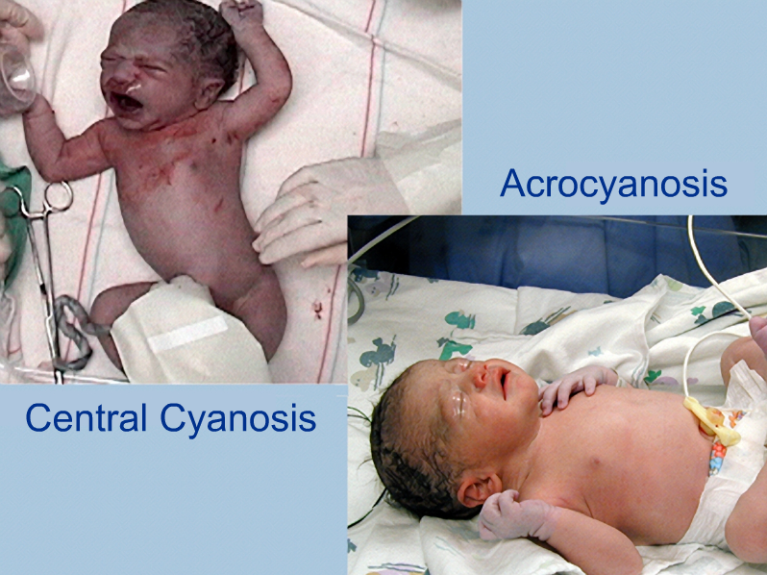
Central Cyanosis and Acrocyanosis
Notes:
Central cyanosis is caused by too little oxygen in the blood and causes a blue hue to the lips, tongue, and central trunk. Acrocyanosis is a blue hue to the hands and feet. Only central cyanosis requires intervention. Studies have shown that a visual assessment of cyanosis is not a reliable indicator of the baby's oxygen saturation and should not be used to guide oxygen therapy. An oximeter should be used to confirm the perception of cyanosis
Instructor Tip: Even babies who will eventually become heavily pigmented will appear “pink” when adequately oxygenated after birth.

Slide 23
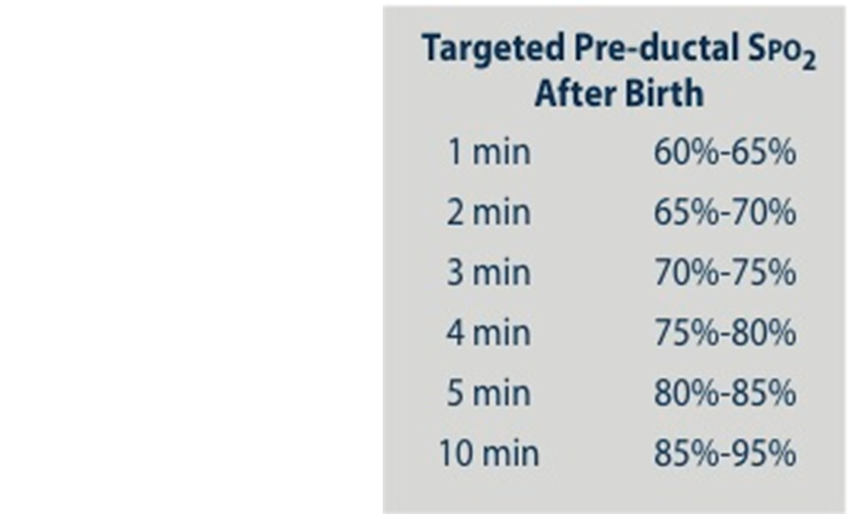
Oximetry
If available, use a pulse oximeter to guide your treatment when resuscitation is anticipated.
Stabilization of ventilation, HR, and oxygenation are priorities
Place oximeter probe on right arm for pre-ductal measurement
Notes:
If available, use a pulse oximeter to guide your treatment when resuscitation is anticipated.
Stabilization of ventilation, HR, and oxygenation are priorities
Place oximeter probe on right arm for pre-ductal measurement

Slide 24
Supplemental Oxygen
Begin with room air
Guided by oximetry (visual assessment of skin color is not reliable)
Preterm may need supplemental oxygen earlier
Notes:
Begin with room air then guided by pulse oximeter, move gradually to supplemental oxygen if needed.
Guided by oximetry (visual assessment of skin color is not reliable)
Preterm may need supplemental oxygen earlier

Slide 25
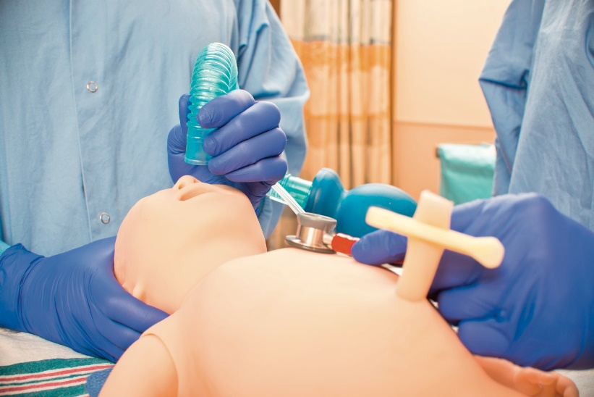
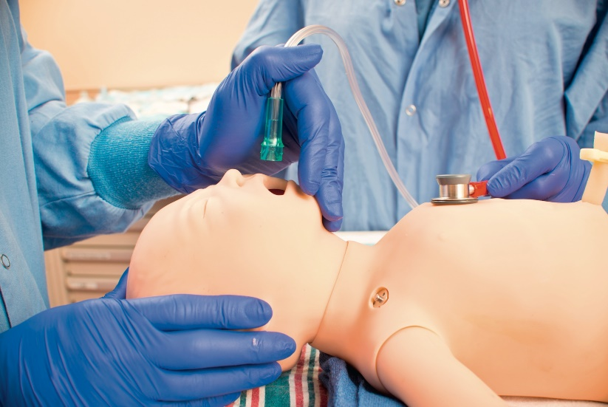
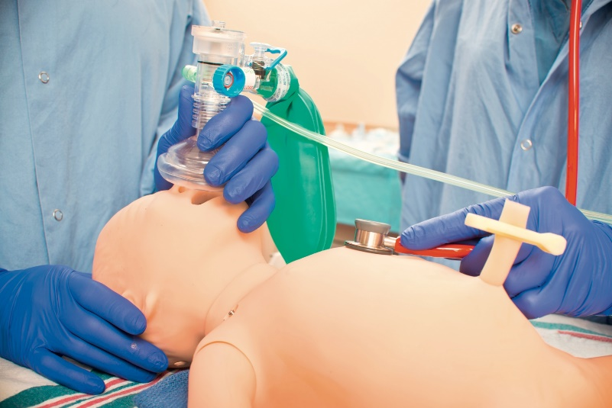
Free-Flow Oxygen
Self-inflating bag and mask - tail
Oxygen tubing
Flow-inflating bag and mask
Notes:
Supplemental oxygen is used only when the oximeter reading remain below the target range for the baby’s age. Free-flow oxygen can be given to a spontaneously breathing baby by the tail of a self-inflating bag and mask, holding oxygen tubing close to the baby’s mouth and nose, and through the mask of a flow- inflating bag.

